Slide 1
Reference Sequence:
ATG TCT GGA TAC CCG AAT GTC
ATG TCA GGA TAC CCG AAT GTC
Substitution
ATG TCT TAC CCG AAT GTC
Deletion

Slide 2
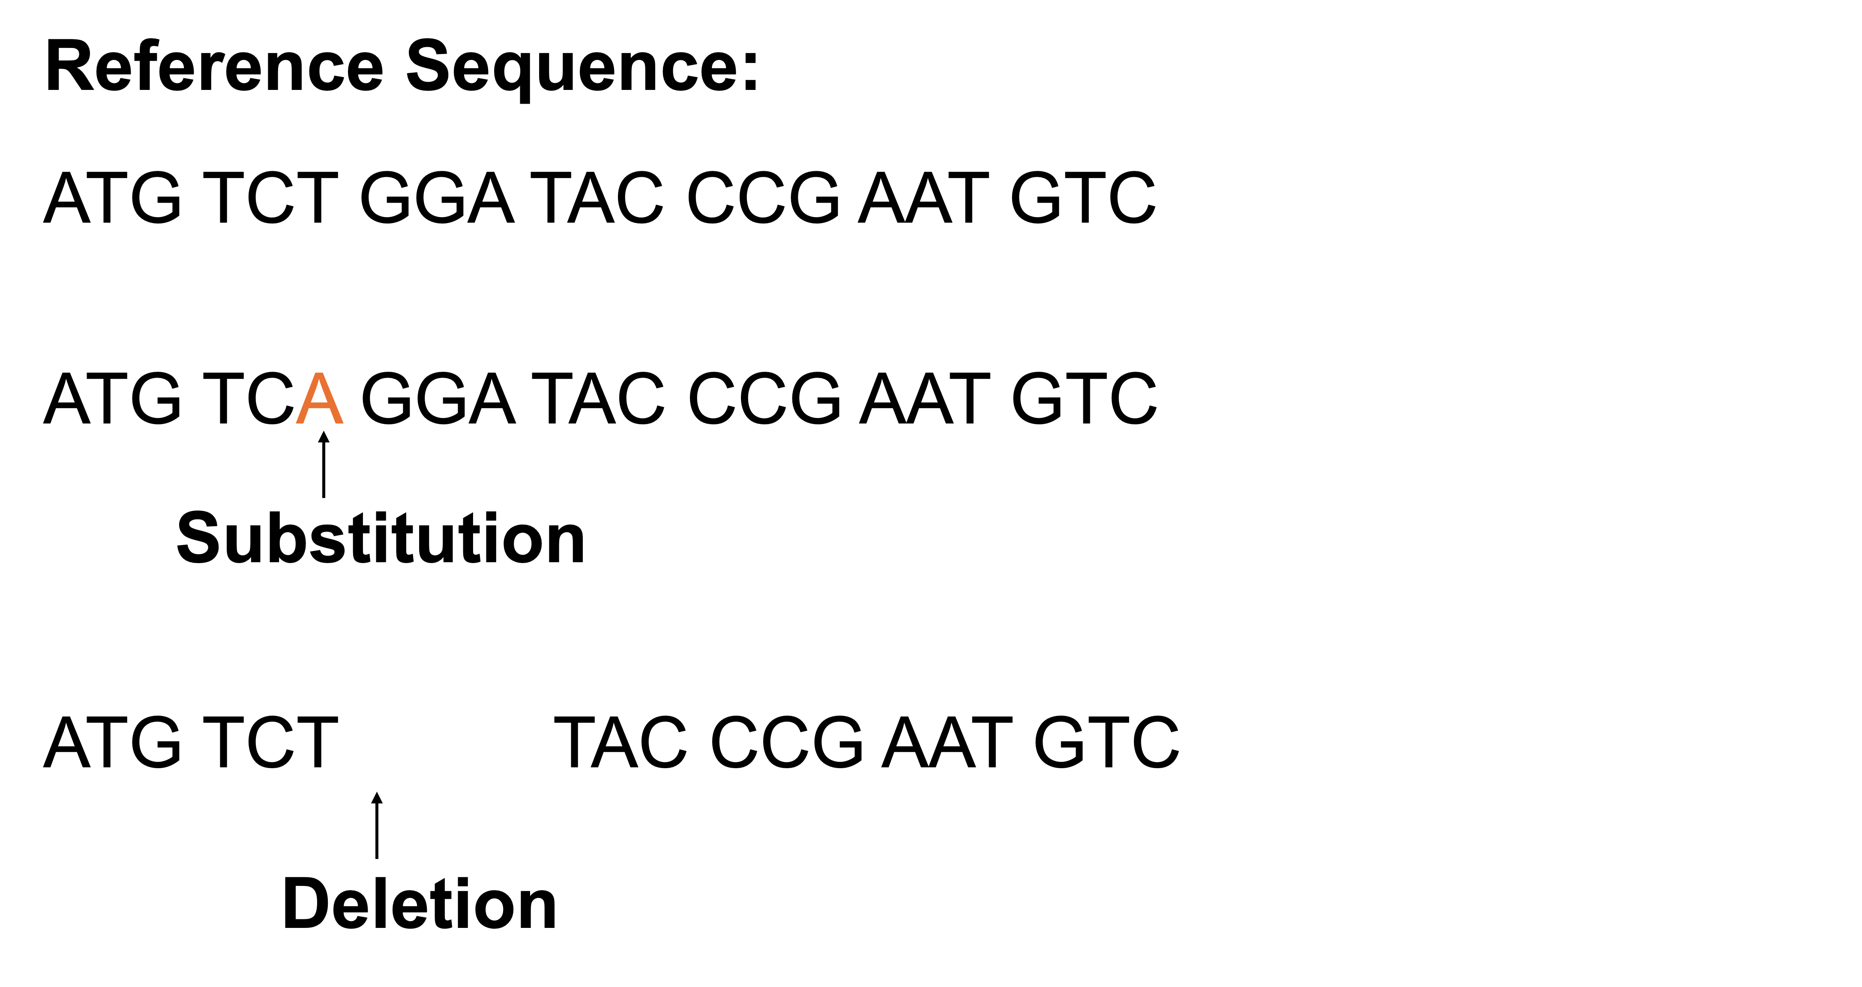
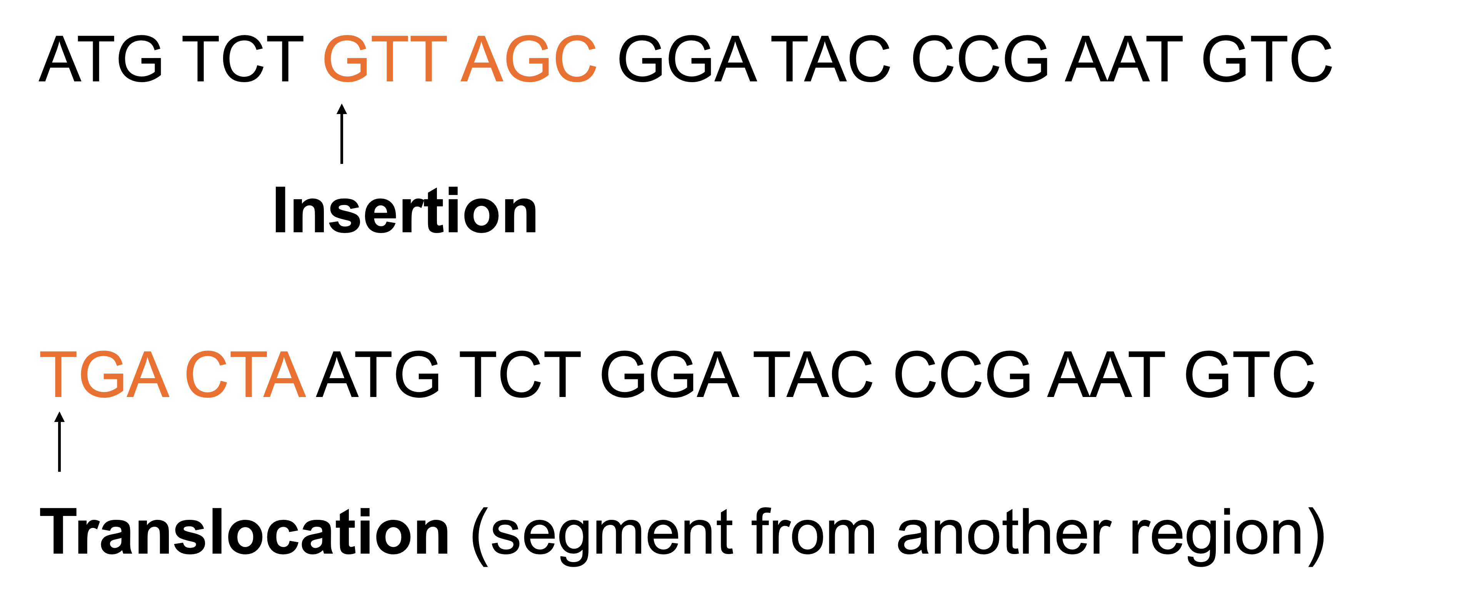

Slide 4
ATG TCT GTT AGC GGA TAC CCG AAT GTC
Insertion
TGA CTA ATG TCT GGA TAC CCG AAT GTC
Translocation (segment from another region)

Slide 5

Individual 1:
Allele A
C T C G T C A C T T C A C
G A G C A G T G A A G T G
C T C A T C A C T T C A C
G A G T A G T G A A G T G
Allele a
The genotype at this SNP: Aa

Slide 6
Individual 2:
Allele a
C T C T T C A C T T C A C
G A G A A G T G A A G T G
C T C A T C A C T T C A C
G A G T A G T G A A G T G
Allele a
The genotype at this SNP: aa

Slide 7
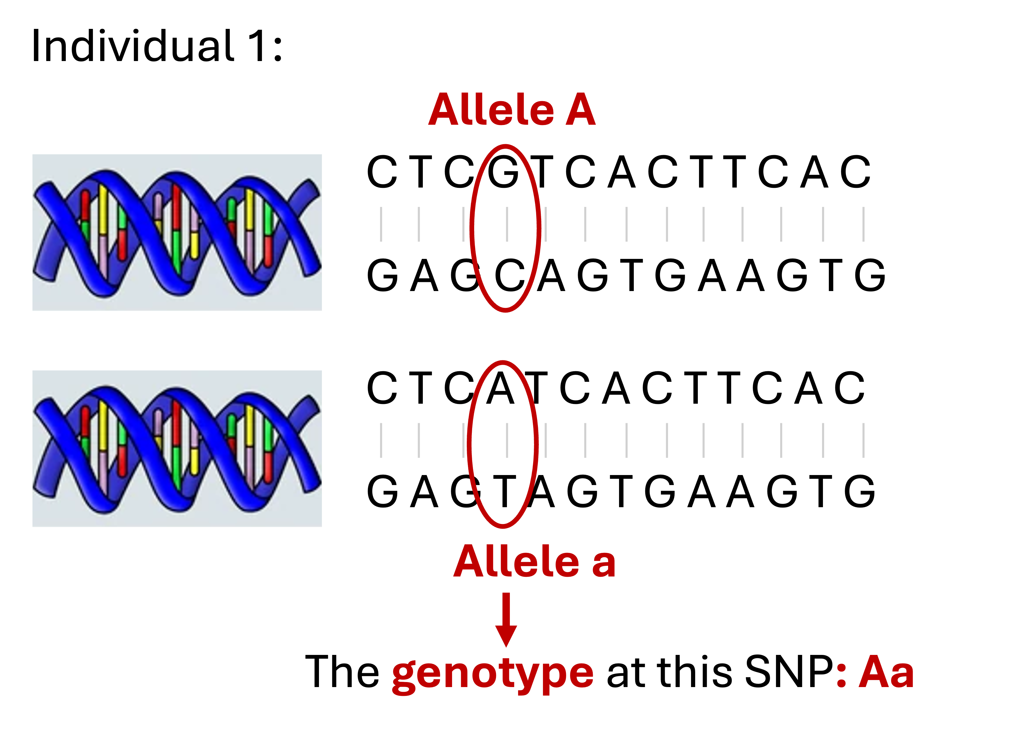


Slide 8
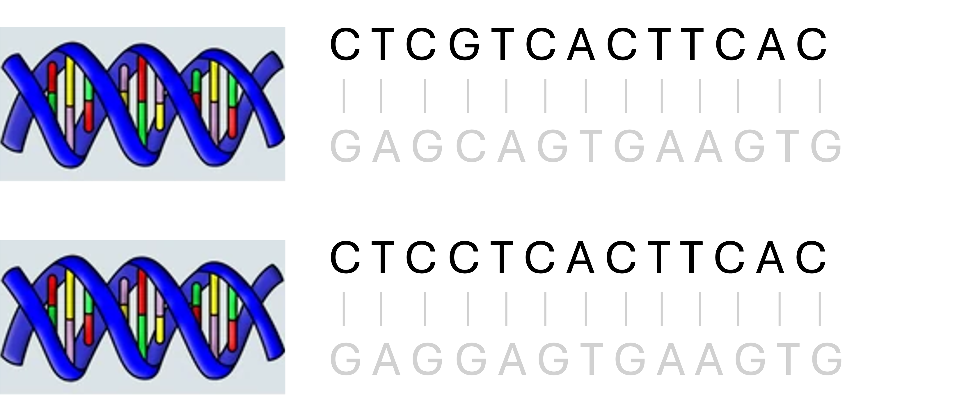
Allele A
Allele a
Genotype: Aa

Slide 9
C T C G T C A C T T C A C

